Slide 1

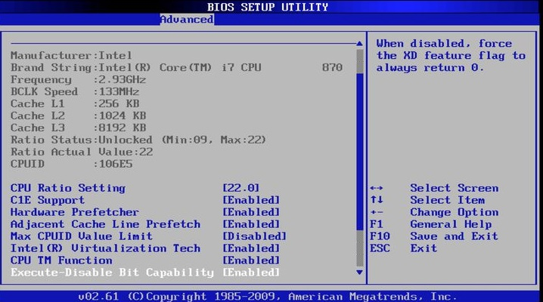
OCR Level 02 – Cambridge Technical
Unit 03 – Building IT Systems
2016 Specification - T/615/1382
LO4 - Be Able to Build and Configure IT Systems to Meet Business Needs

Slide 2
Assessment Criteria
The Learner will | Pass The assessment criteria are the pass requirements for this unit. The learner can: | Merit To achieve a merit the evidence must show that, in addition to the pass criteria, the learner is able to: | Distinction To achieve a distinction the evidence must show that, in addition to the pass and merit criteria, the learner is able to:
1. Understand the roles of IT technical support | P1 - Explain the role of an IT support technician in an organisation |  | D1 - Compare the activities of different IT technician roles
2. Be able to design IT systems to meet business needs | P2: Propose an IT system to meet specified business needs | M1 -Justify how the design meets the specified business needs
3. Be able to select the components for the designed IT systems | P3 - Select the hardware components for the proposed IT system | M2 - Justify why the selected components meet the proposed Specification
 | P4 - Select the software for the proposed IT system
4. Be able to build and configure IT systems to meet business needs | P5 - Build and test the IT system | M3 - Carry out acceptance testing with the client | D2 - Evaluate the results from testing and recommend improvements
 | P6 - Configure and test the IT system

Slide 3
Aim and Purpose
Learning Outcome 4: Be able to build and configure IT systems to meet business needs.
Your task is to: build and test your proposed IT system for Progress Academy.
The SMT of Progress Academy has now instructed you to build the IT system using the hardware and software that you have selected.
When you have completed the physical installation of the hardware and the software, the IT system will then need to be configured to satisfy the requirements of the client and be suitable for use by the end users (teaching staff). Referring to the stated requirements from Progress Academy you must ensure that the IT system has been appropriately configured.
There should be iterative testing as the system is being built and final testing of the system upon completion. Testing should include both the functionality and the configuration of the IT system and it should also include the client when appropriate (the client tests the system for accessibility).
Progress Academy would also like to be informed of any modifications or improvements that may be identified from the test results.

Slide 4
Assessment Criterion P5, P6, M3, D2
P5.1 - Building, i.e.:
assemble hardware components, i.e.:
  processor
  RAM
  hard drive
  graphics/network card
  monitor
  peripherals
install software, i.e.:
  operating system
  productivity software
  collaboration software
  utility software
P6.1 - Configuring, i.e.:
configure system settings, i.e.:
  user accounts
  time/date
  display settings
  application settings
configuring hardware settings, e.g.:
  BIOS
  printer settings
  monitor calibration
M3.1 - Testing, i.e.:
carry out iterative testing
acceptance testing
functional testing
D2.1 - Evaluation, i.e.:
analysis of all test results
identify resolutions
identify improvements
meeting stakeholder requirements

Slide 5
Assessment Criterion P5, P6, M3, D2
LO4 - Be able to build and configure IT systems to meet business needs
P5 - Learners are required to build and test the IT system based on the design specification and selected hardware and software components from LO3.
To evidence this, learners could take pictures and annotate appropriately or they could be videoed carrying out the installation.
P6 - Learners are required to configure and test the IT system for functionality. The evidence should include the planned test plan with expected and actual results, identification of errors, resolution of errors and retesting.
M3 - Learners are required to carry out acceptance testing with the client to judge whether the system meets the business needs. To evidence this, learners will present the completed acceptance testing form from the client.
D2 - Learners are required to evaluate the results from their testing in P5, P6 and M3. The learner will analyse the test results and recommend improvements to the system. This could be in the form of a report supported by the analysis of the test results.
Are all the parts in a computer necessary Could I build my own processor How do I make my PC faster What is Moore’s Law Is a laptop better than a PC Can I change my CPU without changing my motherboard. Tablet vs, Laptops

Slide 6
Assignment Scenario
In order for any organisation to run effectively and successfully achieve its targets a range of supporting systems will need to be used.
It is now common practice that the vital systems within an organisation are automated and computer controlled which promotes accuracy and efficiency.
This has resulted in the increasing need for IT support technicians who are responsible for the design, development, implementation and testing of those systems. The role of an IT support technician requires an enhanced level of knowledge about hardware, software and networks and is now a vital role within most organisations.
Progress Academy – IT support systems
Progress Academy is an education establishment with 500 students. The current systems in the academy are paper-based but the Academy would like to reduce the errors and environmental impact of paper-based systems through the use of automation.
The subsequent use of computer controlled systems will not only have a positive environmental impact but should improve the speed and accuracy at which the systems operate.
The Academy has identified three priority systems that require immediate automation - the student registration system, the monitoring of student grades and the control of stock and resources in the Academy e.g. paper, pens and equipment.

Slide 7
Assignment Scenario
There are also secondary systems which are considered important to the effective daily running of the Academy. These include fault reporting, financial management and building maintenance routines.
The SMT at the Academy has very little experience with the design and implementation of IT systems and so has recently employed an IT support technician who will be responsible for the design and building of the IT support systems within it.
Progress Academy – IT system specification
Progress Academy has stated the priority requirements that their IT system must have. These include:
  printing documentation and scanning documents or images;
  storing up to 500GB of information and images;
  transferring data to hand held devices, e.g. tablets or laptops;
  specialist display devices where appropriate;
  hosting video conferencing;
  a simple and easy to use graphical user interface;
  networking functionality to enable files transfer and sharing;
  a range of suitable software applications appropriate for teaching staff and students;
  internet access including appropriate security measures;
  authorised user only access;
  appropriate backup and recovery systems.

Slide 8
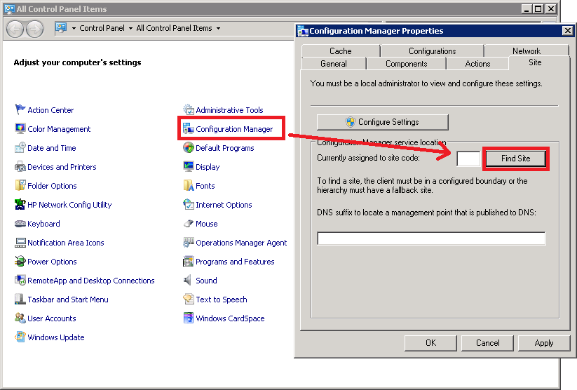
P5.1 – Building a System
P5.1 - Building
For this task, which should take some time per student, or it can be done in a small group but needs to be evidenced as a series of photographs and annotated.
Students need to demonstrate installing the following components into a computer.
  processor
  RAM
  hard drive
  graphics/network card
  monitor
  Peripherals
install software, i.e.:
  operating system
  productivity software
  collaboration software
  utility software

Slide 9
P5.1 – Building a System
For this task you should be given the appropriate hardware in anti-static bags. This should consist of a box, motherboard, power supply, CPU, Memory, hard drive, CD drive and associated cables. You should also have a Monitor, Mouse and keyboard. You will also need a camera to evidence the construction of the computer system.
The following tasks will need to be evidenced in order:
Attach the anti-static wristband to the box.
Screw the motherboard to the base unit.
Screw the power supply to the base unit.
Remove the CPU from the anti static bag, place and clamp it on the motherboard.
Remove the Memory chips from the anti static bag, place and clamp them on the motherboard.
Remove the Hard Drive and CD Drive from the anti static bag and screw them into place, checking the master and slave jumpers.
Use the SATA or IDE cables to connect the Hard Drive and CD drive to the motherboard.
Seal the base unit up and connect a power cable, monitor, keyboard and mouse to the base unit.
Switch the machine on and go into BIOS (tapping F1 or F3 as the machine powers on)
Check that the hardware and components have successfully been configured in BIOS.
P5.1 - equipment (e.g. monitor, printer, modem/router, keyboard, mouse, speakers, microphone, camera).
P5.1 – Task 01 - Set up and verify a standalone computer system, installing the core hardware components

Slide 10
M3.1 – Testing a System – Iterative Tests
M3.1 - Task 02 – Perform Iterative testing during the installation and setup of the computer system.
Test could involve the following areas of the system or others of your choice but they must be relevant:
The learner must evidence that they have tested the configured system for functionality. This must include the use of a test plan/table which shows the tests, the rationale for the choice of tests, expected outcomes, actual outcomes and the results of testing. They should include the retesting of any failures this could be supported by annotated before and after screenshots in evidencing the results of testing.
Printer Settings | Control panel Finds Components | BIOS Password | Screen Resolution | Accessibility Options | Language Settings
Virus Updates | Firewall Updated | Utility Software runs | Word Language Setting | User Accounts | Admin Account
Test Number | Type of Test | What Am I Testing | What Am I Expecting To Happen | What Did Happen | Action Taken | Evidence
1 | Normal | English Dictionary in Word | When I spell colour in Word it should not appear as a spelling mistake because of the dictionary set to US | Spelling was correct for English Dictionary | None needed | Print screen 1 and 2

Slide 11
P5.2 – Set up a standalone computer system - OS
For this task you should be given the appropriate software to install on a DVD or CD. This should consist of the operating system software (e.g. Windows; Linux, MacOS). This section will take time and needs to be evidence either as photographs of you setting up the OS or as a Video demonstration of the stages.
The entire process should take about 1½ hours and should be done as one steady stream. Otherwise you can take a break at stage 5 and continue next lesson.
The following tasks need to be evidenced:
  Switch the machine on and check in BIOS that the DVD drive is bootable.
  Place the OS in the DVD drive and resume the boot or restart.
  Follow the instructions on the installation of the OS.
  Set the time, date, region, keyboard country, and network protocols etc.
  Let the machine reboot and finish configuring the OS.
  When done show setting the screen resolution to an appropriate scale.
  Go into control panels and confirm the setup of all the current hardware is correct, specifically the sound, network card and screen.
  P5.2 – Task 03 - Set up a standalone computer system, installing an appropriate OS.

Slide 12
P5.3 – Set up a standalone computer system - Hardware
For this task you should be given the appropriate hardware in anti-static bags. This should consist of a Graphics card, Sound Card, Network card. Each stage of this should be evidenced either as photographs of you setting up the hardware or as a Video demonstration of the stages.
The entire process should take about 1 hour and should be done as one steady stream.
Connect yourself with the anti static wrist band and switch off and unplug the computer.
Open the Box and connect up the Graphics Card to the Motherboard, securing it with a screw.
Connect up the Network Card to the Motherboard, securing it with a screw.
Connect up the Sound Card to the Motherboard, securing it with a screw.
Disconnect the anti static band, power the machine on and using the driver disks supplied with the hardware components you just installed set them up on the OS.
Verify in Control Panels that they are configured properly.
P5.3 - Task 04 - Set up and install the device drivers for a network card, sound card and graphics card with evidence.
Graphics Card | Sound Card | Network Card

Slide 13
P5.4 – Set up a standalone computer system - Hardware
For this task you should be given the appropriate hardware. This should consist of a Printer, Speakers, Microphone and Monitor. Each stage of this should be evidenced either as photographs of you setting up the hardware or as a Video demonstration of the stages.
The entire process should take about 30mins and should be done as one steady stream.
With the OS running, connect up a Printer to the USB sockets and switch the printer on.
Using the driver disks supplied with the hardware components you just connected set them up on the OS or Verify through Control Panels that they it has been successfully installed.
With the OS running, configure the monitor setting on the computer to a higher resolution with the appropriate drivers.
Using the driver disks supplied with the hardware components you just connected set them up on the OS or Verify through Control Panels that they it has been successfully installed.
With the OS running, connect up a Microphone and Speakers to the Jack sockets and switch the speakers on.
Using the driver disks supplied with the hardware components you just connected set them up on the OS or Verify through Control Panels that they it has been successfully installed.
P5.4 – Task 05 - Set up and install the device drivers for a Printer, Monitor, Microphone and Speakers with evidence.
Printer | Monitor | Microphone and Speakers

Slide 14
P5.5 – Set up a standalone computer system - Software
For this task you should be given the appropriate Software on DVD or Memory Stick. This should consist of a MSOffice or Open Office, a Virus Checker like Avast, Panda or AVG, and a Firewall Program like Zone Alarm. These can be downloaded for free at FileHippo or from their respective websites. Each stage of this should be evidenced either as photographs of you setting the software or as a Video demonstration of the stages.
Applications software (e.g. Office Software suites)
With the OS running, insert the Office Disk and it will either self boot or go into File manager, look at the drive and run the setup file.
Follow the instructions, you want a stand alone full install without some of the extra office components. In your write up, justify the ones you do not want in terms of HD space and making it easier for the user.
Configure the Language and location of the files.
Continue the set up to the end.
Test that Excel, Powerpoint, Access and Work works.
Security software (e.g. virus checkers, firewalls)
Using the downloaded or provided files (if downloaded they will need to be unzipped) run the setup.
Configure the location of each
Configure the settings like when to update. Show them working when complete by running a virus scan and showing the Firewall and virus checker icon in the right hand corner.
  P5.5 – Task 06 - Set up and configure Application and Security software on the OS.
Application Software | Virus Checker | Firewall

Slide 15
P6.1 – Configuring a System
P6.1 - Configuring
For P6 you need to demonstrate through the same method configuring the system through control panels of the OS equivalent and demonstrate through annotated images the following:
configure system settings, i.e.:
  user accounts
  time/date
  display settings
  application settings
configuring hardware settings, e.g.:
  BIOS
  printer settings
  monitor calibration

Slide 16
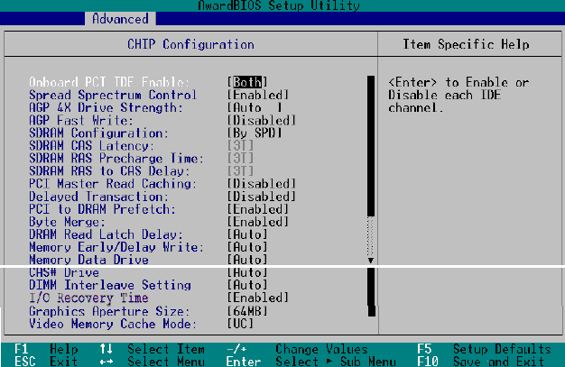
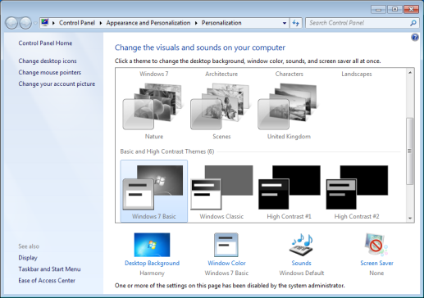
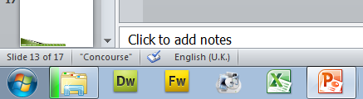
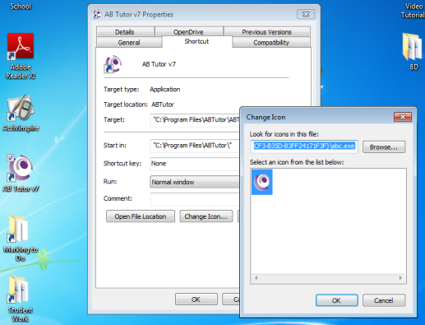
P6.1 – Configuring a System – Bios and Customising
The Bios on the computer can be useful for things other than configuring the standard IDE ports, IRQ and settings and internal hardware, it can also be used to configure the Computer Power Settings such as the Stand-By time, how much power consumption it uses, when to dim the screen etc. to make the computer more friendly.
The BIOS is also a dangerous place to allow members of staff to be in, from there they can turn the Hard Drives off, change the boot configuration to load from Memory Stick and bypass the OS.
For this task you will need to configure the BIOS for Power Saving mode and Power Management and set up a password on the BIOS to restrict users from bypassing the system.
Background | Icons and Desktop | Screen Saving | Taskbar and Start Menu

Slide 17
P6.1 – Configuring a System – Bios and Customising
P6.1 – Task 07 – Set the BIOS configuration using a password and editing power management options. Justify the need and benefits of doing this.
The desktop is what most staff see as much they will look at Office, it is there when they start up the OS, when they shut down, when they need to find things.
Users then to customise their desktop to suit their needs, setting a background image changing the size and location of the icons, setting a screensaver, removing unwanted programs from the Start Menu and adding their own shortcuts to applications as a desktop icon or as a Toolbar on the Task Bar.
Background | Icons and Desktop | Screen Saving | Taskbar and Start Menu

Slide 18
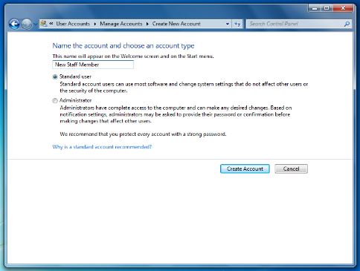
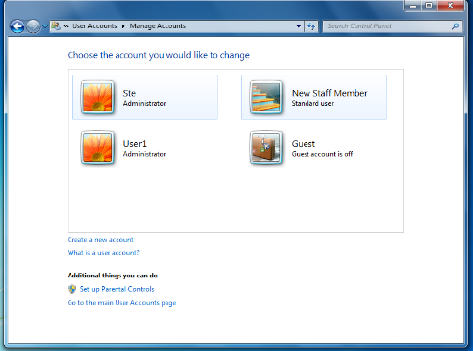
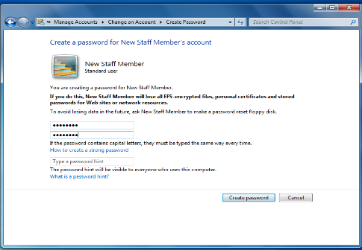
P6.3 – Configuring a System – Accounts
The System you have set up will be accessed by more than one person, this is called hot-swapping. It is necessary therefor in order to protect information, setting and for privacy, for the System to be configured for multiple accounts, one Administrator account and at least two standard accounts. You will only need to evidence the creation of one of these standard account and one admin account and test that it works by logging off.
Either follow the guide for Windows, or the following steps:
Go Into Control Panels and click on User Accounts
Under User Accounts click on Give other users access to this computer
Add a new User and set the rights for that user as an Administrator, set a login name and password for the user, and remember what it is, make it simple this time.
Configure the user image etc. to suit the needs of the user.
Save the user account, log Off and Log on as this user.
Set up a second user on a lower level and test the account.
P6.2 – Task 08 – Annotate evidence on how to set up Start up options and user accounts and levels of access and explain the reasons why this is necessary.

Slide 19
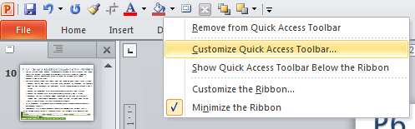
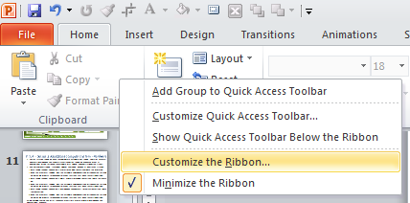
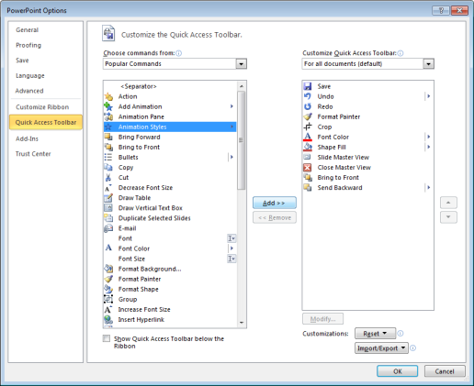
P6.4 – Configuring a System – Updating and Customising
The System you have set up with the anti virus program and Firewall needs to be configured to update the .dat file on a regular basis. To do this you will need to demonstrate this by configuring them both. Click here for an example. To do this either follow the guide or take he following steps:
Right click on the Virus Checker and select options or Run the Virus Checker and select options.
Configure the options, the location of the vault, how regular the update, the warning to give to the user.
Explain each stage and the variety of settings you have chosen with a justification of what you did and the importance of doing so for the user.
Then do the same for the Firewall, Right Click, Options, Update etc.
P6.4 – Task 09 – Annotate evidence on how to set up manage and update the virus and firewall definition files and explain the reasons why this is necessary.

Slide 20
P6.4 – Configuring a System – Updating and Customising
The last stage of configuring the OS and programs for the user before the company can start using the machine is to customise the toolbars within the applications to suit the user. There are two toolbars that can be customise. The standard ribbon and the quick access toolbar. To do this:
Right Click on the Toolbar and select Customise Quick Access Toolbar
Add the icons you want from Popular or from All.
Click on Add, click on OK and it will stay there until you deliberately remove it.
P6.5 – Task 10 – Annotate evidence on how to customise the toolbar on applications and explain the reasons why this is necessary.
You should demonstrate how to do this on Word, Excel and Powerpoint with at least three customisations each.
P6.6 – Task 11 – Annotate evidence of setting the printer settings on your system for Paper Size, Quality and orientation.

Slide 21
M3.2 – Testing a System – Acceptance, Functional
M3.2 - Task 12 - Test a configured computer system for Acceptance and functional purposes.
Acceptance testing should include tests on how the system meets the clients needs, evidence should include accessibility tests and the evidence of client involvement in the tests. Functional tests should be about how the system runs. Test could involve the following areas of the system or others of your choice but they must be relevant:
Test Data Type:
  Operational (No data as such)
  Normal (What you would expect to be used)
  Erroneous (Tests that should produce an error)
  Boundary (Testing to see if the Screen refuses the highest resolution setting)
  Extreme (Virus checker, Defragmentaion or Scandisk)
  The learner must evidence that they have tested the configured system for functionality. This must include the use of a test plan/table which shows the tests, the rationale for the choice of tests, expected outcomes, actual outcomes and the results of testing.
  They should include the retesting of any failures this could be supported by annotated before and after screenshots in evidencing the results of testing.
  M3.3 – Task 13 – Create and present an acceptance testing form to the client.
Device Drivers | Account status | Accessibility | Screen Resolution and Shortcuts | Accessibility Options | Language Settings
Virus Updates | Firewall Status | Customised toolbars | Default File and Folder Locations | Start up options | Scandisk and Defragmentation

Slide 22
D2.1 – Evaluating a System
For D2 you need to create a report on the system and all the tests you have done for the setup and usage. Create a report with the following headings and explain, with the line of the test and more detailed feedback on the results the following:
  Hardware installation process
  OS installation process
  Hardware configuration within OS
  Desktop Configuration
  Application configuration
  Accessibility options
  Network Setup
  Identify resolutions and recommend future precautions.
D2.1 – Task 14 - Evaluate the results from their testing in P5, P6 and M3.
For D2.2 you need to identify improvements to the system and the manner of setting up the system. An example of a suggested improvement is on the next slide. These need to take two forms:
Identify improvements
Meeting stakeholder requirements
D2.2 – Task 15 – Recommend improvements to the system. This could be in the form of a report supported by the analysis of the test results.
Give a detailed justification why these changes were made and how they will improve the functionality of the System.

Slide 23
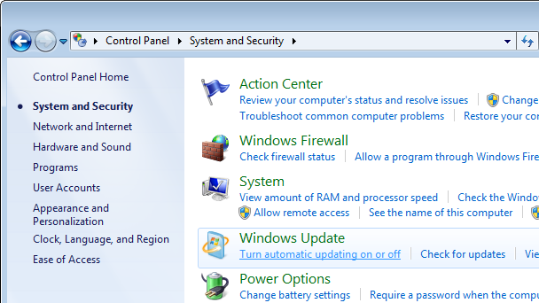
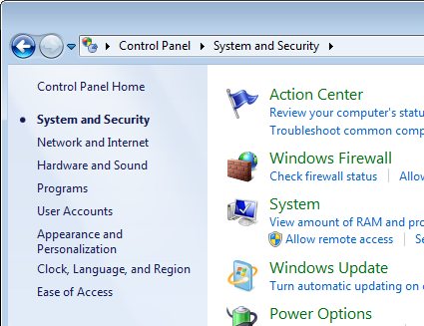
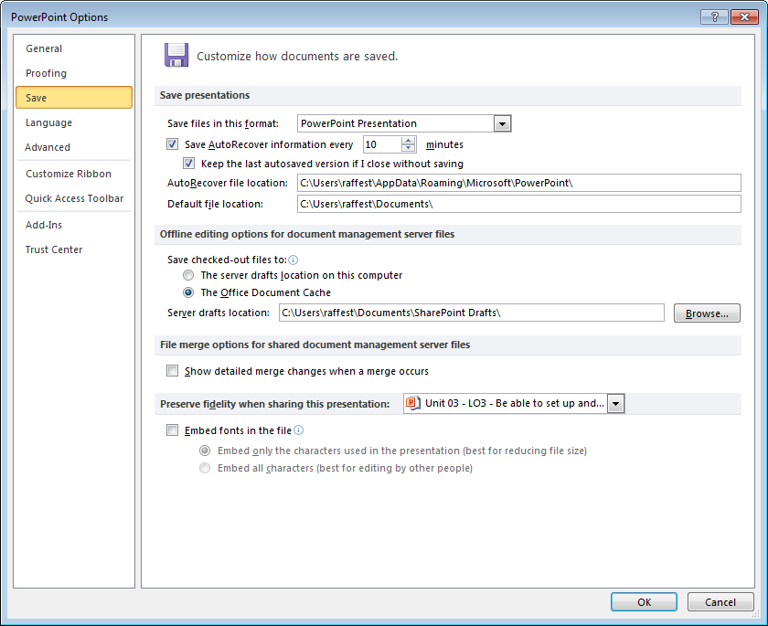
D2.2 – Suggested Improvements
With the testing done and the system ready to be used, you need to make some forward planning decisions to keep the system functioning happily. These are things that can be pre-set so the user does not realise they are happening.
  Configure the Virus Checker for updates and schedule a scan once a week.
  Configure the Firewall to update once a week when the machine is likely to used the least or not at all.
  Create a System Restore Point
  Configure the Windows updates to check every time the system goes online for device and system updates.
  Configure the backup file and location of the Office applications so they save every 15mins into a location different from the default file location.
Explain the importance of doing this and the benefits this will have to the user.
Virus Checker | Firewall | Restore Point | Windows Update | Office backup

Slide 24
LO4 – Assessment Criteria
P5.1 – Task 01 - Set up and verify a standalone computer system, installing the core hardware components
M3.1 - Task 02 – Perform Iterative testing during the installation and setup of the computer system.
P5.2 – Task 03 - Set up a standalone computer system, installing an appropriate OS.
P5.3 - Task 04 - Set up and install the device drivers for a network card, sound card and graphics card with evidence.
P5.4 – Task 05 - Set up and install the device drivers for a Printer, Monitor, Microphone and Speakers with evidence.
P5.5 – Task 06 - Set up and configure Application and Security software on the OS.
P6.1 – Task 07 – Set the BIOS configuration using a password and editing power management options. Justify the need and benefits of doing this.
P6.2 – Task 08 – Annotate evidence on how to set up Start up options and user accounts and levels of access and explain the reasons why this is necessary.
P6.4 – Task 09 – Annotate evidence on how to set up manage and update the virus and firewall definition files and explain the reasons why this is necessary.
P6.5 – Task 10 – Annotate evidence on how to customise the toolbar on applications and explain the reasons why this is necessary.
P6.6 – Task 11 – Annotate evidence of setting the printer settings on your system for Paper Size, Quality and orientation.
M3.2 - Task 12 - Test a configured computer system for Acceptance and functional purposes.
M3.2 – Task 13 – Create and present an acceptance testing form to the client.
D2.1 – Task 14 - Evaluate the results from their testing in P5, P6 and M3.
D2.2 – Task 15 – Recommend improvements to the system. This could be in the form of a report supported by the analysis of the test results.

